Slide 1
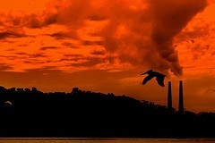
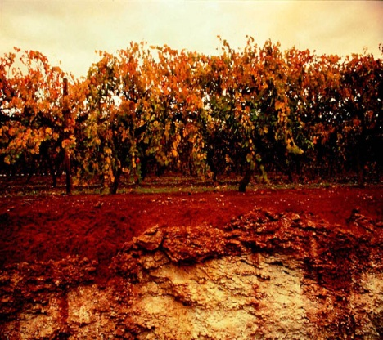
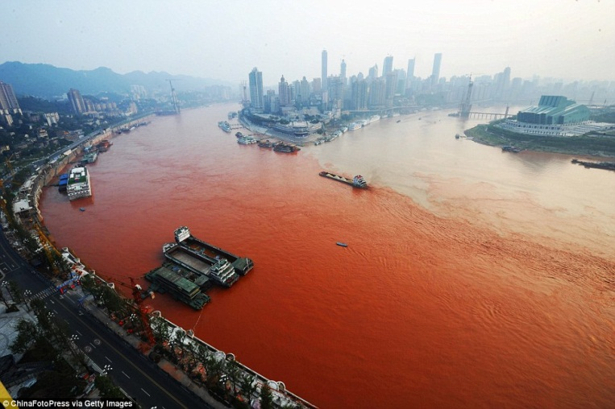
Pollution
Ajit Kr Chauhan
Assistant Professor

Slide 2
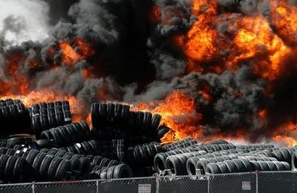
Pollution
Life on earth exists in a very delicate balance
Any imbalance in this ecosystem due to environmental pollution results in contamination.
Pollution became a popular issue after World War II.
Pollution dates back all the way to the prehistoric times when man first started to create fires.

Slide 3
Main Types of Pollution
Soil Pollution: The soil pollution is defined as the presence of materials in the soil which are harmful to the living beings when they cross their threshold concentration levels.
Water Pollution: is the contamination of water bodies such as lakes, rivers, oceans, and groundwater caused by human activities, which can be harmful to organisms and plants which live in these water bodies.
Air Pollution: The condition in which air is contaminated by foreign substances, or the substances themselves.
Noise Pollution: Environmental noise, as from vehicles or machinery, that is annoying, distracting, or physically harmful.

Slide 4
Other types of Pollution
Radioactive Pollution: Material that emits radiationenergy in the form of alpha, beta, or gamma particles or rays - all of which can damage living tissue.
Thermal Pollution: harm to lakes and rivers resulting from the release of excessive waste heat into them.
Light Pollution: Illumination of the night sky by electric lights, as in an urban area, that interferes with astronomical observation.
Visual Pollution: different visually unattractive elements of a certain landscape

Slide 5
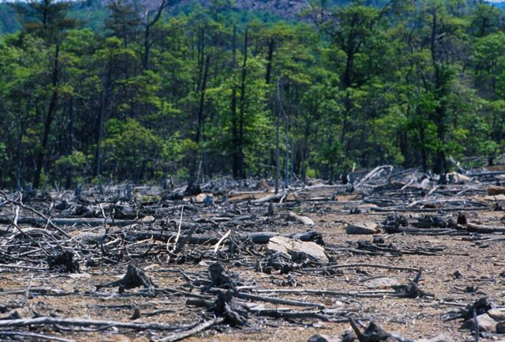
Soil Pollution
Soil contamination or soil pollution is caused by the presence of xenobiotic (human-made) chemicals or other alteration in the natural soil environment.
Contamination is correlated with the degree of industrialization and intensity of chemical usage
In North America and Western Europe that the extent of contaminated land is best known
Developing countries tend to be less tightly regulated

Slide 6
Causes of Soil Pollution
Corrosion of underground storage tanks.
Application of pesticides and fertilizers.
Mining
Oil and fuel dumping
Disposal of coal ash
Leaching from landfills
Direct discharge of industrial wastes to the soil
Drainage of contaminated surface water into the soil

Slide 7
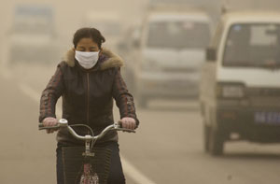
Human influence
Soil pollution starts with the flawed concept of throwing trash on the side of a road and throwing out your dustbin on the road.
Besides the tons household plastic, industrial dumping of man-made chemicals is also done.
not just restricted to developing countries, but highly developed and advanced countries as well.
Agricultural advancement has also played a part in laying many a green pastures barren.

Slide 8
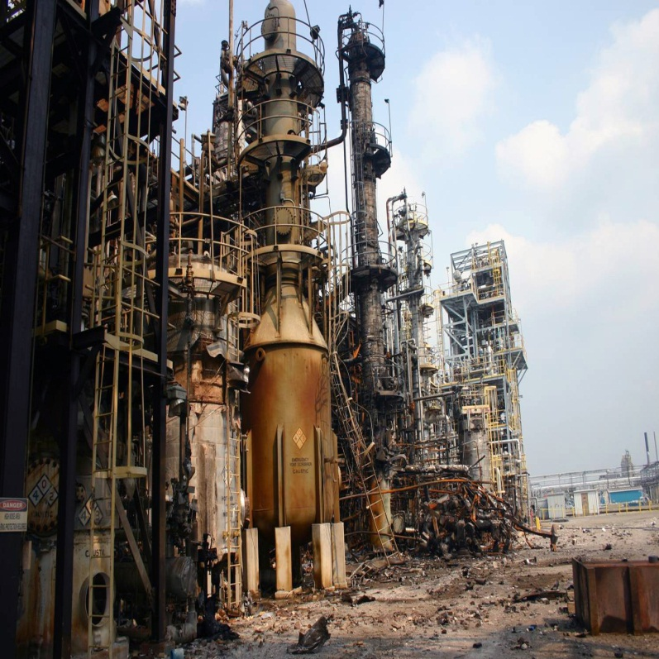
Soil pollution facts
Soil is a non-renewable resource with more potential to degrade.
Most countries have very little control over soil pollutant dumping.
In U.S. alone, millions of tons of chemical waste is being dumped in the soil and sea, and spewed in air resulting in long-term adverse implications on life in general.
Developed and developing countries have now put a major legal framework and clean-up program in place, to deal with soil pollution.

Slide 9
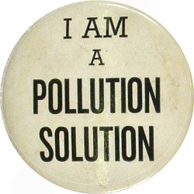
Soil Pollution Solutions
Reduction of Acid Rain
Sulfur dioxide emissions can cause acid rain and forest destruction.
Reduce Waste
Consider the amount of needlessly generated waste.
Improve Agriculture.
Wetland Restoration
Help restore polluted wetlands.
Reduction of Human Impact
Finally, simply reduce your negative impact on the environment.

Slide 10
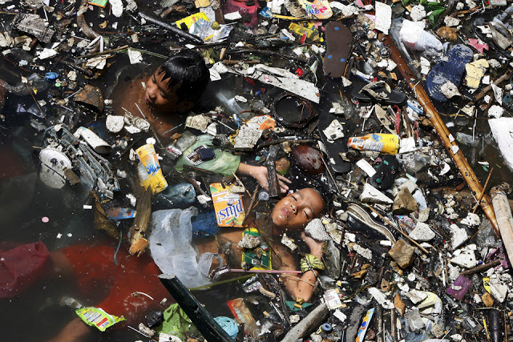
Water Pollution
Water pollution affects plants and organisms living in these areas of dirty water.
Water pollution requires on going evaluation and revision of water resource policy at all levels.
It has been suggested that it is the leading worldwide cause of deaths and diseases.

Slide 11
Water Pollution effects
it accounts for the deaths of more than 14,000 people daily worldwide.
90% of China's cities suffer from some degree of water pollution.
nearly 500 million people lack access to safe drinking water.
Aside from human impact, there are natural causes as well, such as: volcanoes, algae blooms, storms, and earthquakes.
Groundwater pollution, is made from ongoing releases of chemical or radionuclide contaminants into soil.

Slide 12
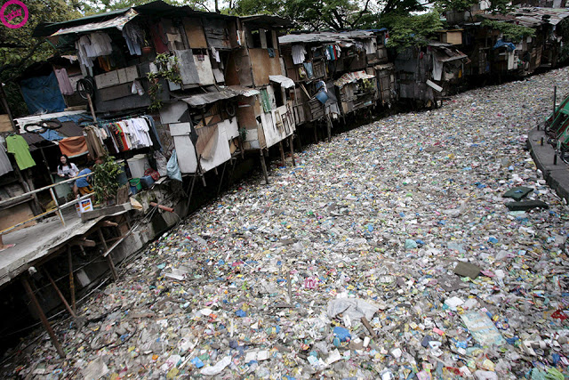
Water Pollution Solutions
laws do exist and if everybody would abide by it, we would be one step closer to clean water
don’t use pesticides or other chemicals
driving less with car or/and use puplic transportation
use less plastics and don’t litter.

Slide 13
Air Pollution
Air pollution occurs when the air contains gases, dust, fumes or odor in harmful amounts, amounts which could be harmful to the health or comfort of humans and animals or which could cause damage to plants and materials.
Because of air pollution the balance in the Earth’s atmosphere is being disturbed by humans with the increase of the famous greenhouse effect.
Air pollution in wildlife areas can cause birth defects, impotency and disease in animals.
Ozone depletion is probably the most talked about reason for stopping pollution in general.

Slide 14
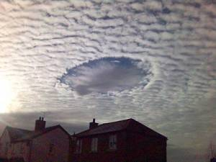
Air Pollution effects
The ozone layer is gradually being destroyed by man-made chemicals
The UV rays can have big effects on humans and can cause skin cancer, cataracts and impaired immune systems.
But with the increasing amounts of carbon dioxide and methane release the Earths average temperature will surely rise unless a change is made.

Slide 15
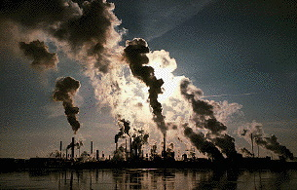
Types Of Air Toxins
Toxic air pollutants can be considered into 3 categories:
Gases, liquid aerosols and particles.
Gases including benzene, toluene and xylenes.
Liquids like perchloroethylene and methylene chloride.
Particles including heavy metals- cadmium, chromium, lead and mercury.

Slide 16
Air Pollution solution
Enforcing pollution emission limits on cars, trucks and factories;
Developing State Environmental Protection Policies (SEPP): these set rules that cars, trucks, factories and businesses must follow to minimise pollution;
Managing Air Monitoring Stations, which helps EPA monitor the health of the air;
Talking with community, industry and government;
Supporting education campaigns

Slide 17
Noise Pollution
Noise is really any unwanted sound, some sound that isn't natural to given environment and it causes disturbance to not only natural processes but can also cause harm to human society.
Noise pollution can become a big environmental problem in some areas.
More serious noise can even significantly reduce usable habitats for many sound-sensible animals, and can in the end even result in extinction of some species
Noise pollution doesn't have only negative effect on animals but can also have negative impact on human health.

Slide 18
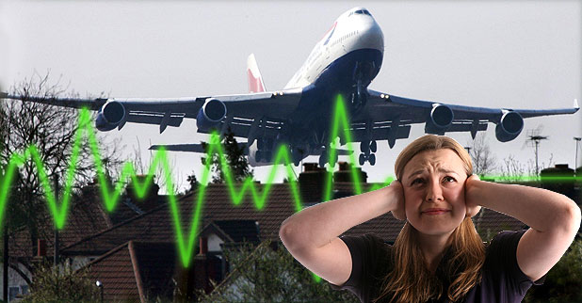
Noise Pollution Effects
Exposure to too much noise can lead to stress, aggression, sleep disturbance, hearing loss, and different other psychological issues.
Noise pollution doesn't have only negative effect on animals but can also have negative impact on human health.

Slide 19
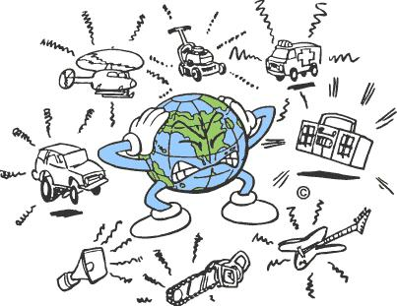
What Causes Noise Pollution ?
Transportation
Lightning Hum
Car Alarms/Sirens
Power Tools
Office Equipment
Construction Work
Noisy People
Factory Machinery
Different Audio Speakers

Slide 20
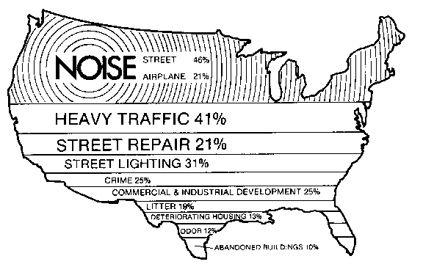
Noise Pollution Solution
Strick laws f.ex :
Less dessible allowed
Limited flights
More electrocars (which arent loud)
More regulations against noise

Slide 21
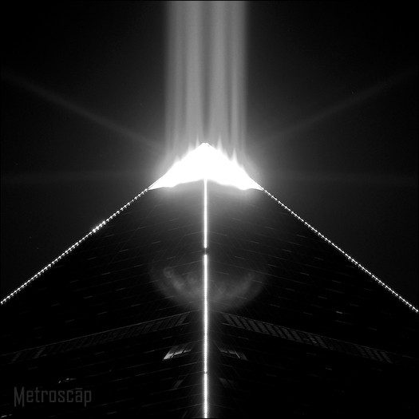
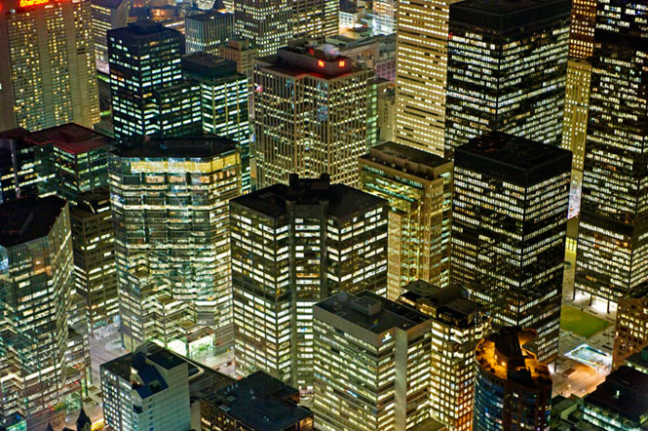
Light Pollution
Light pollution, is an excessive or obtrusive artificial light pollution which is introduced by humans, directly or indirectly, of artificial light into the environment.
Degradation of photic habitat by artificial light
-Alteration of natural light levels in the outdoor environment owing to artificial light sources
-Light pollution is the alteration of light levels in the outdoor environment due to man-made sources of light.

Slide 22
Light Pollution effects
Indoor light pollution is such alteration of light levels in the indoor environment due to sources of light.:
Light pollution competes with starlight in the night sky for urban residents,
interferes with astronomical observatories and,
like any other form of pollution, disrupts ecosystems and has adverse health effects.
Light pollution can be divided into two main types
-Sky glow: Unpleasant light that intrudes on an otherwise natural or low-light setting
-Overillumination : Excessive light (generally indoors) that leads to discomfort and adverse health effects.

Slide 23
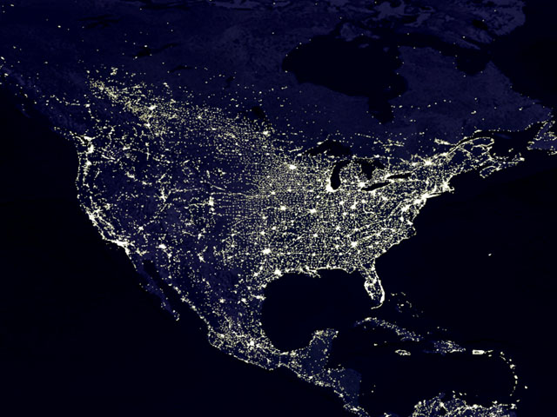
Light Pollution Conclusion
Light pollution is a side effect of industrial civilization.
but even relatively small amounts of light can be noticed and create problems.
The International Dark-Sky Association (IDA) is one non-profit advocacy group involved in this movement.

Slide 24
Light Pollution Solutions
This is the government's responsibility to educate people and give them the solutions.
people need to be told about the major effects and how that issue can affect them
One of the solutions is to use motion sensors.
helps people to light their houses at night automatically.
People could get used to the dark.
reflectors are recommended to be used so the pollution will be reduced and they’re also cheap.

Slide 25

The Kyoto Protocol
The Kyoto Protocol is an international agreement linked to the United Nations Framework Convention on Climate Change, which commits its Parties by setting internationally binding emission reduction targets.
The Kyoto Protocol was adopted in Kyoto, Japan, on 11 December 1997 and entered into force on 16 February 2005.
Its first commitment period started in 2008 and ended in 2012.

Slide 26
The Kyoto Protocol
Under the Protocol, countries must meet their targets primarily through national measures.
The Kyoto Mechanisms are:
  International Emissions Trading
  Clean Development Mechanism
  Joint implementation
Under the Protocol, countries' actual emissions have to be monitored and precise records have to be kept of the trades carried out.
The Kyoto Protocol is seen as an important first step towards a truly global emission reduction regime that will stabilize GHG emissions, and can provide the architecture for the future international agreement on climate change.

Slide 27
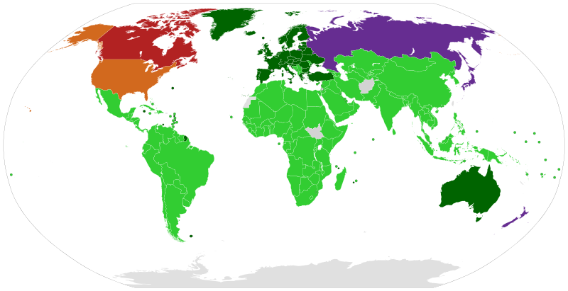
The Kyoto Protocol
Dark Green Parties; Annex I & II countries with binding targets
Light Green Parties; Developing countries without binding targets
Grey States not Party to the Protocol
Orange Signatory country with no intention to ratify the treaty, with no binding targets
Red Countries that have denounced the Protocol, with no binding targets
Purple Parties with no binding targets in the second period, which previously had targets

Slide 28
Conclusion
Join hands and work together towards a brighter future
Think about what you are doing and what its consequences are
Don‘t litter
Use enviromently friendly things, such as; electric cars, light bulps, bicycles, rechargable batteries and much more.
Don‘t forget to recycle !
Lets try to make our planet more green every day

Slide 29

Thank you for listening !

